Slide 1
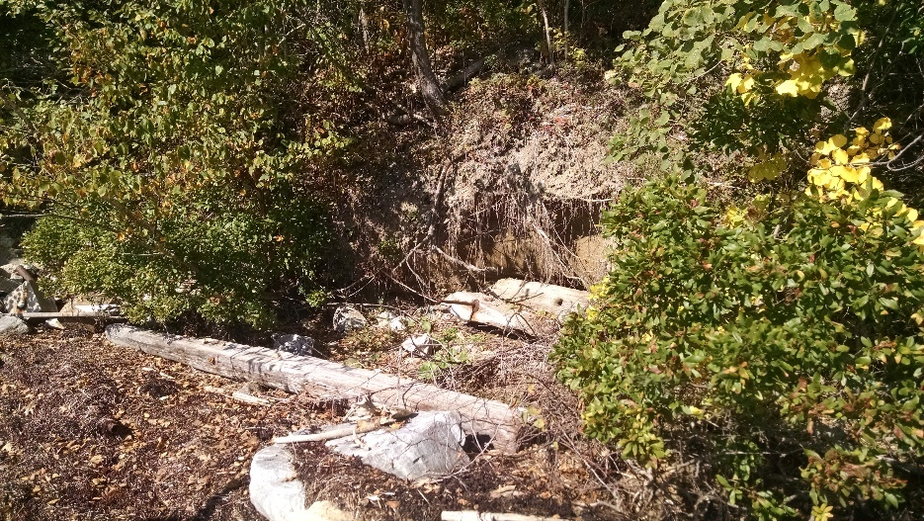
Building Resiliency Along Maine’s Bluff Coastline: Bustins Island Case Study
Developing a Decision Tree and Coastal Stabilization Alternatives
Along Maine’s Casco Bay
Presented by Troy Barry, Fluvial Geomorphologist
Damon Yakovleff, Environmental Planner
July 14, 2017
Notes:
Note: The photos on the title slide are place holders. Replace them with photos relevant to your presentation.

Slide 2
Building Resiliency Along Maine’s Coastline:
The Bustins Island Case Study Presentation
sponsored by the
Bustins Island Landscape Committee
in alignment with the Bustins Island Comprehensive Plan 2012-2020

Slide 3
Building Resiliency Along Maine’s Coastline
Casco Bay Shorelines & Erosion
Traditional Shoreline Stabilization Practices
Case Studies
  Upland - Riparian - Intertidal
Living Shoreline or Soft Stabilization approach
  Biomimicry
Shoreline Management Assessment (SMA)

Slide 4
Project Case Studies
Bustins Island, Freeport
Mitchell Field, Harpswell
Mackworth Island, Falmouth
17 Webb Field, Brunswick

Slide 5
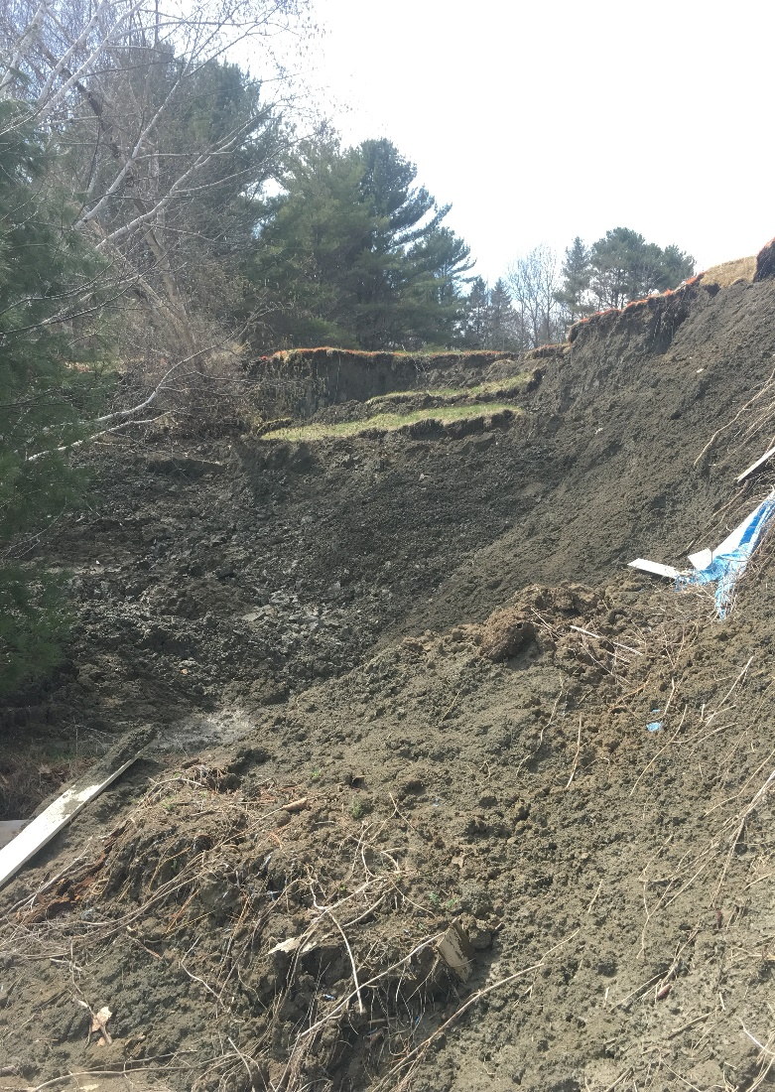
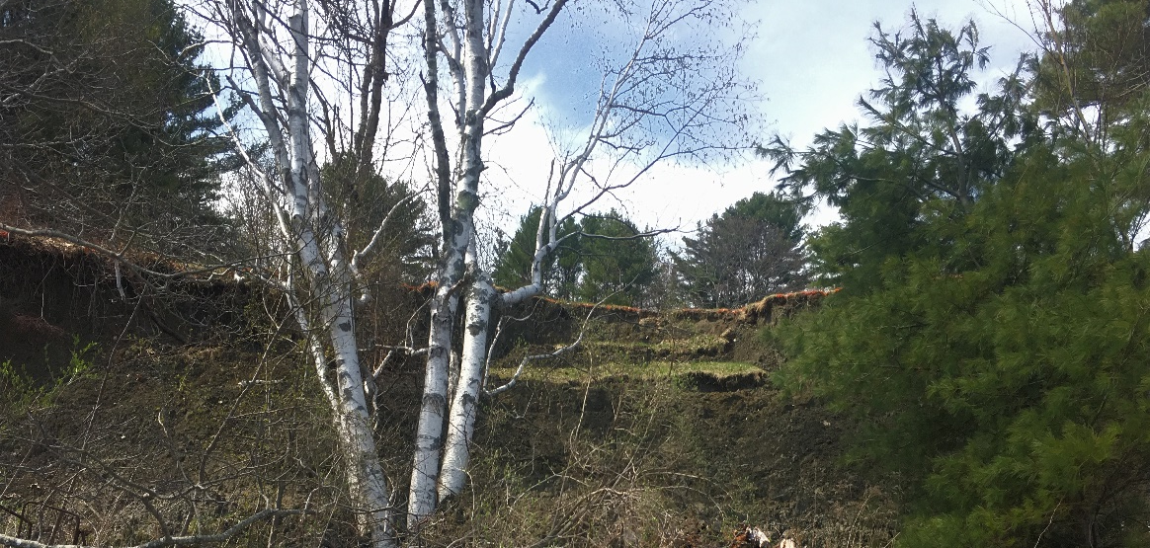
Why Does this matter?
Massive Slope Failure: Brunswick, Maine

Slide 6
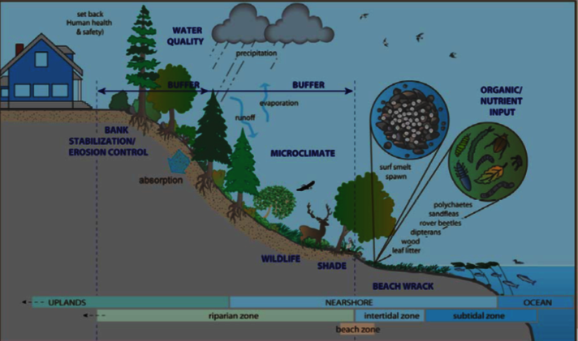
Shoreline Types:
Marsh
  Balanced sediment input & vegetation
Mudflat
  Shallow nearshore
Rock Dominated
  Intermittent
Sediment Bank
  Riparian zone
Pocket Beach
  Shallow intertidal

Slide 7
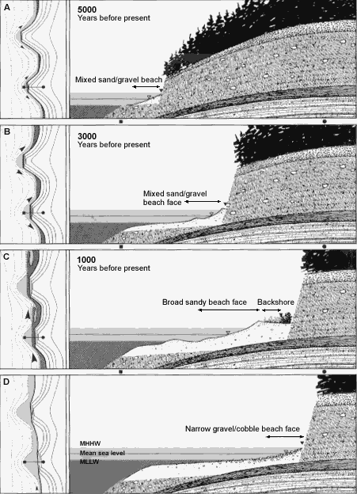
Factors Contributing to weathering and erosion of bluffs

Slide 8
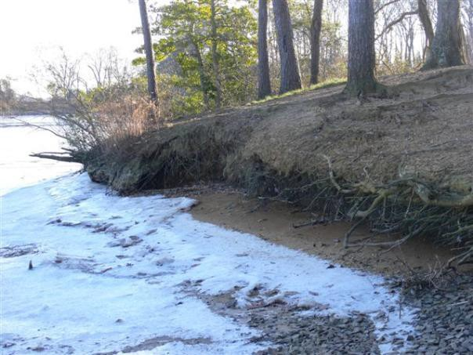
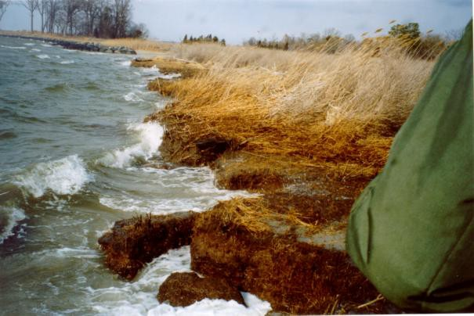
Erosion Rates and Risk
Low Erosion: 2-4 ft/y
Slight Erosion: 0-2 ft/y

Slide 9
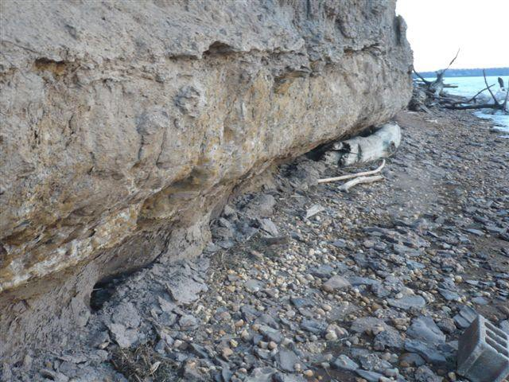
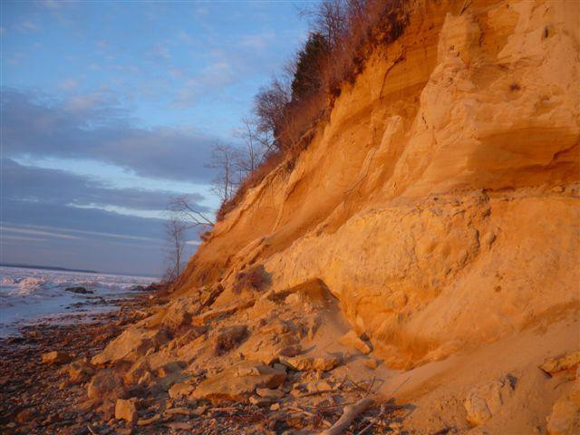
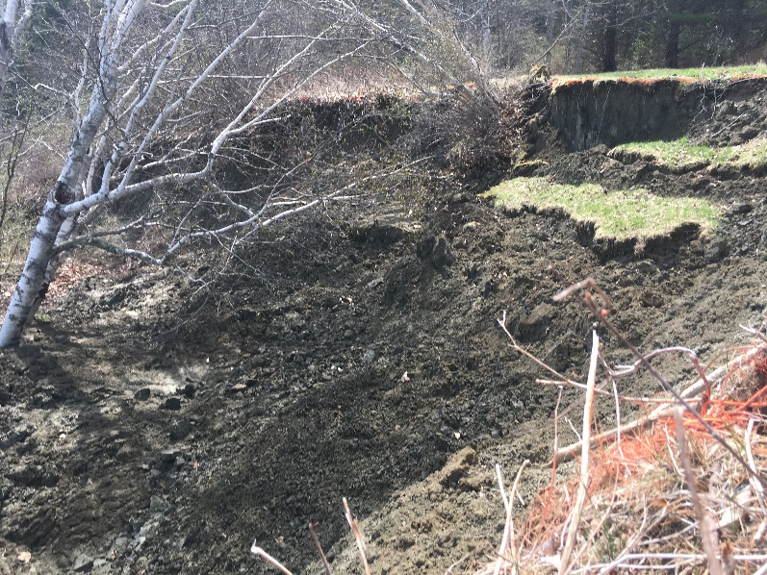
Erosion Rates and Risk
High Erosion: 8+ ft/y
Moderate Erosion: 4-8 ft/y

Slide 10
Intent to provide guidance:
Reconnaissance Level Assessment (RLA) (You are here!)
  Desktop Review, Instability Rating
Prediction Level Assessment (PLA)
  Focus Areas: Upland – Riparian - Intertidal
Design Level Assessment (DLA)
  Conceptual Design
  Living Shoreline and/or Soft Stabilization approach

Slide 11
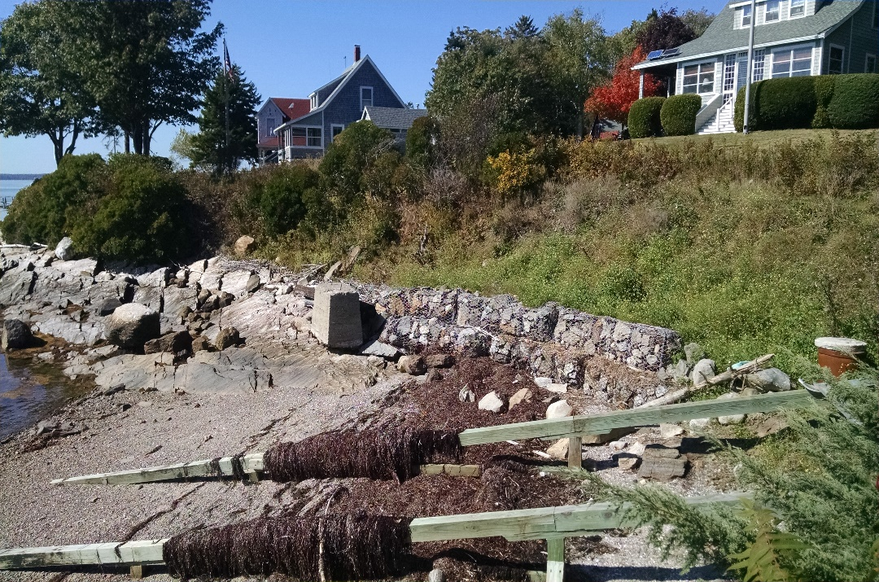
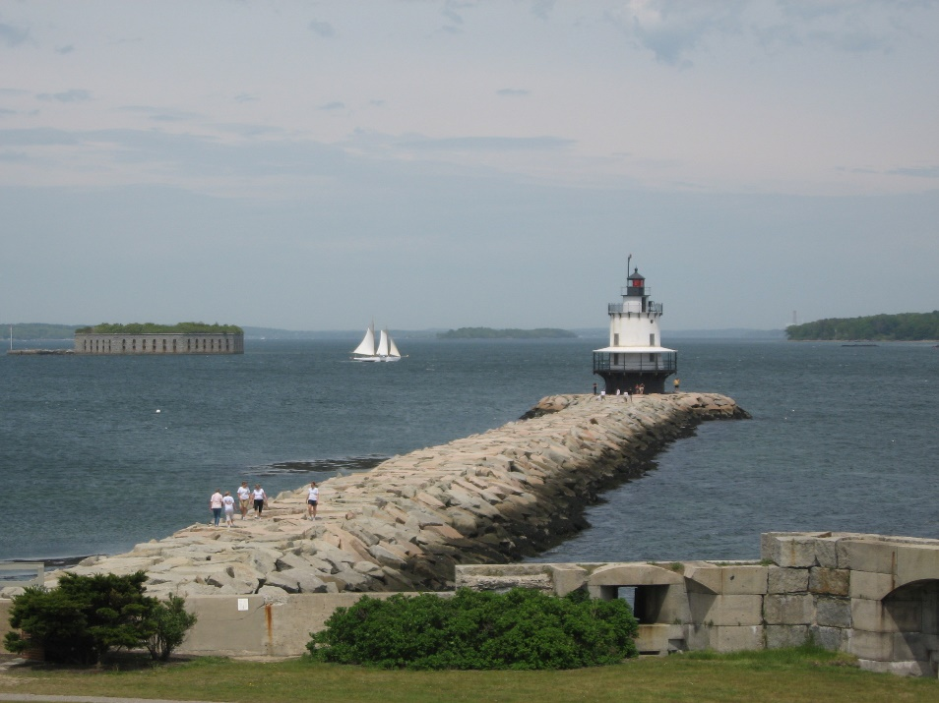
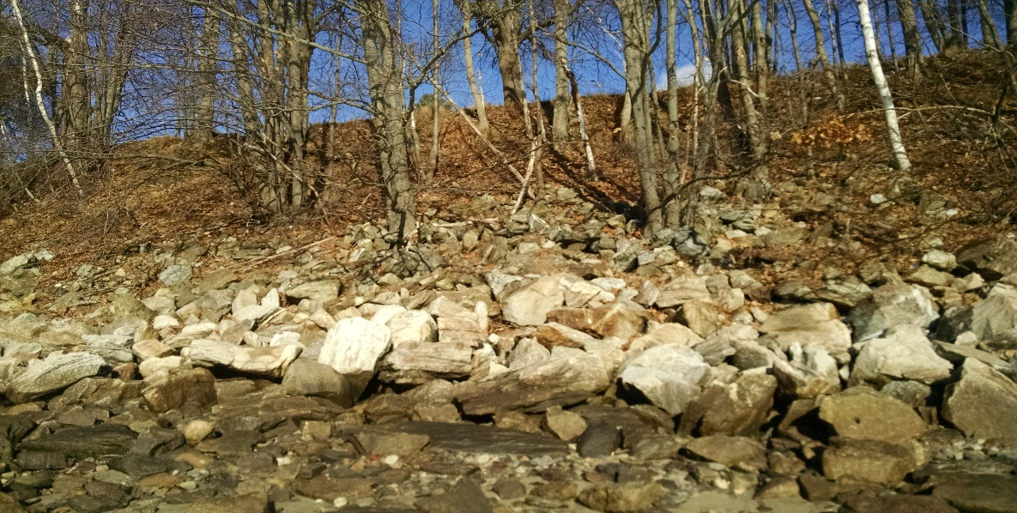
Traditional Stabilization Practices
Riprap
Bulkheads
Jetties & Groins

Slide 12
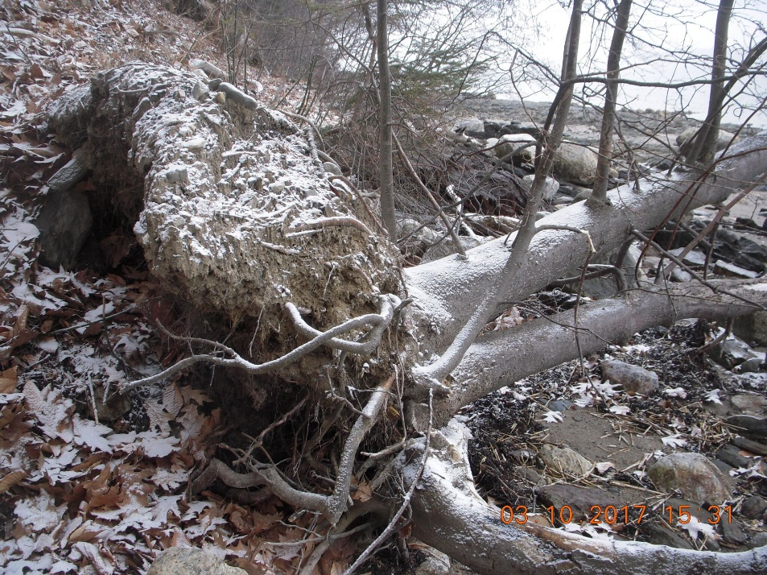
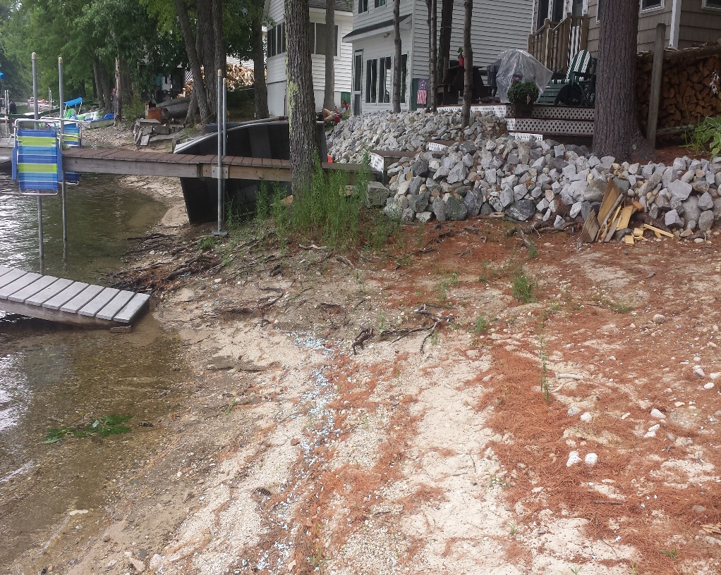
Traditional Stabilization Drawbacks
Accelerated Erosion
New deposition pattern
Turbidity
Energy deflection
Sediment interference
Degrading fish habitat
Aquatic & Terrestrial connectivity loss

Slide 13
Ecological Advantages of
Living Shorelines
Shallow water habitat = higher abundance and diversity of aquatic species both nearshore and offshore.
Maintain a link between aquatic and upland habitats, providing shoreline access for wildlife and recreation.
Maintains natural aesthetic.

Slide 14
Physical Advantages of
Living Shorelines
Improve water quality by settling sediments and filtering pollution.
Absorb wave energy, storm surge and flood waters.
Maintain natural shoreline dynamics and sand movement.
Costs comparable to “structural” options

Slide 15
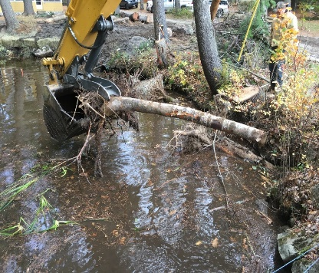
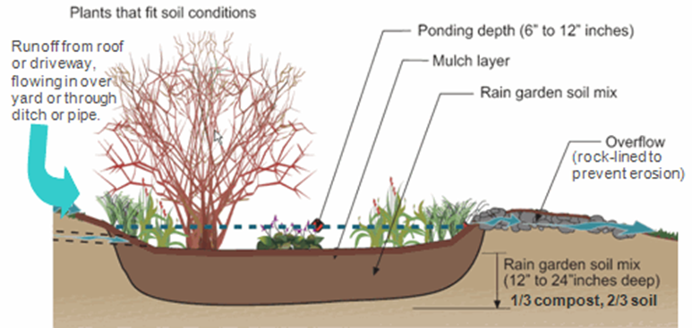
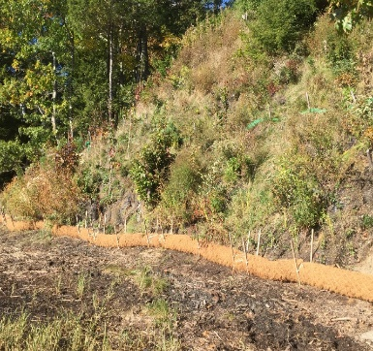
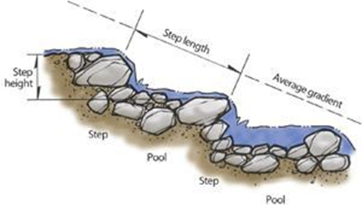
Conceptual Biomimicry
Coir Logs & Vegetation
Rootwads, Brush Mattress, Vanes

Slide 16
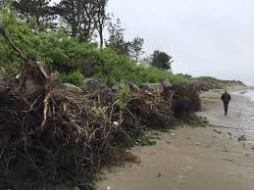
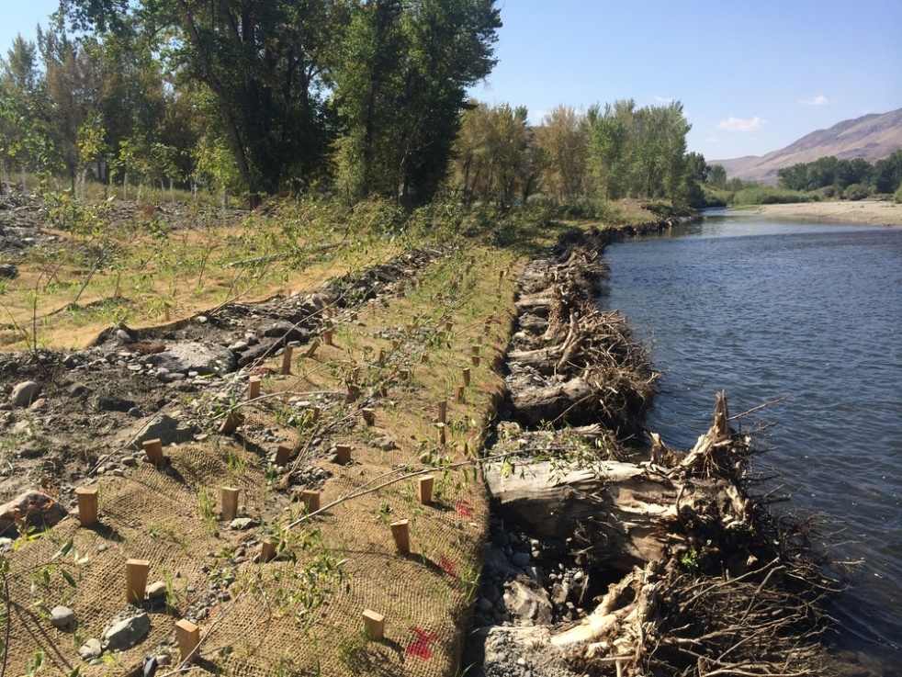
Living Stabilization
What works for ME
  Each site is unique
    RLA-PLA-DLA
  Ecological & Physical advantages
  Project implementation, Collaboration & Monitoring
Guidelines

Slide 17
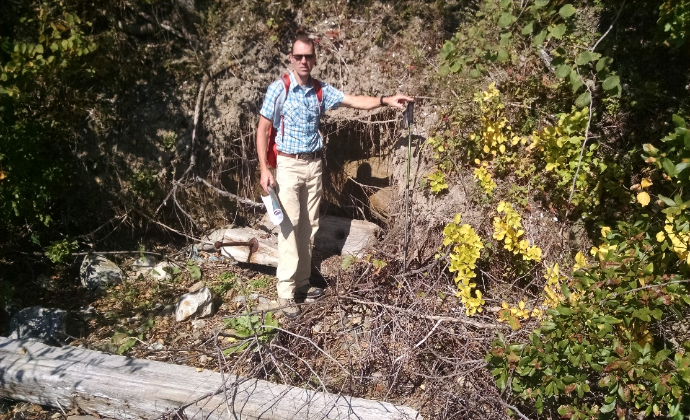
Application to Bustins Island

Slide 18
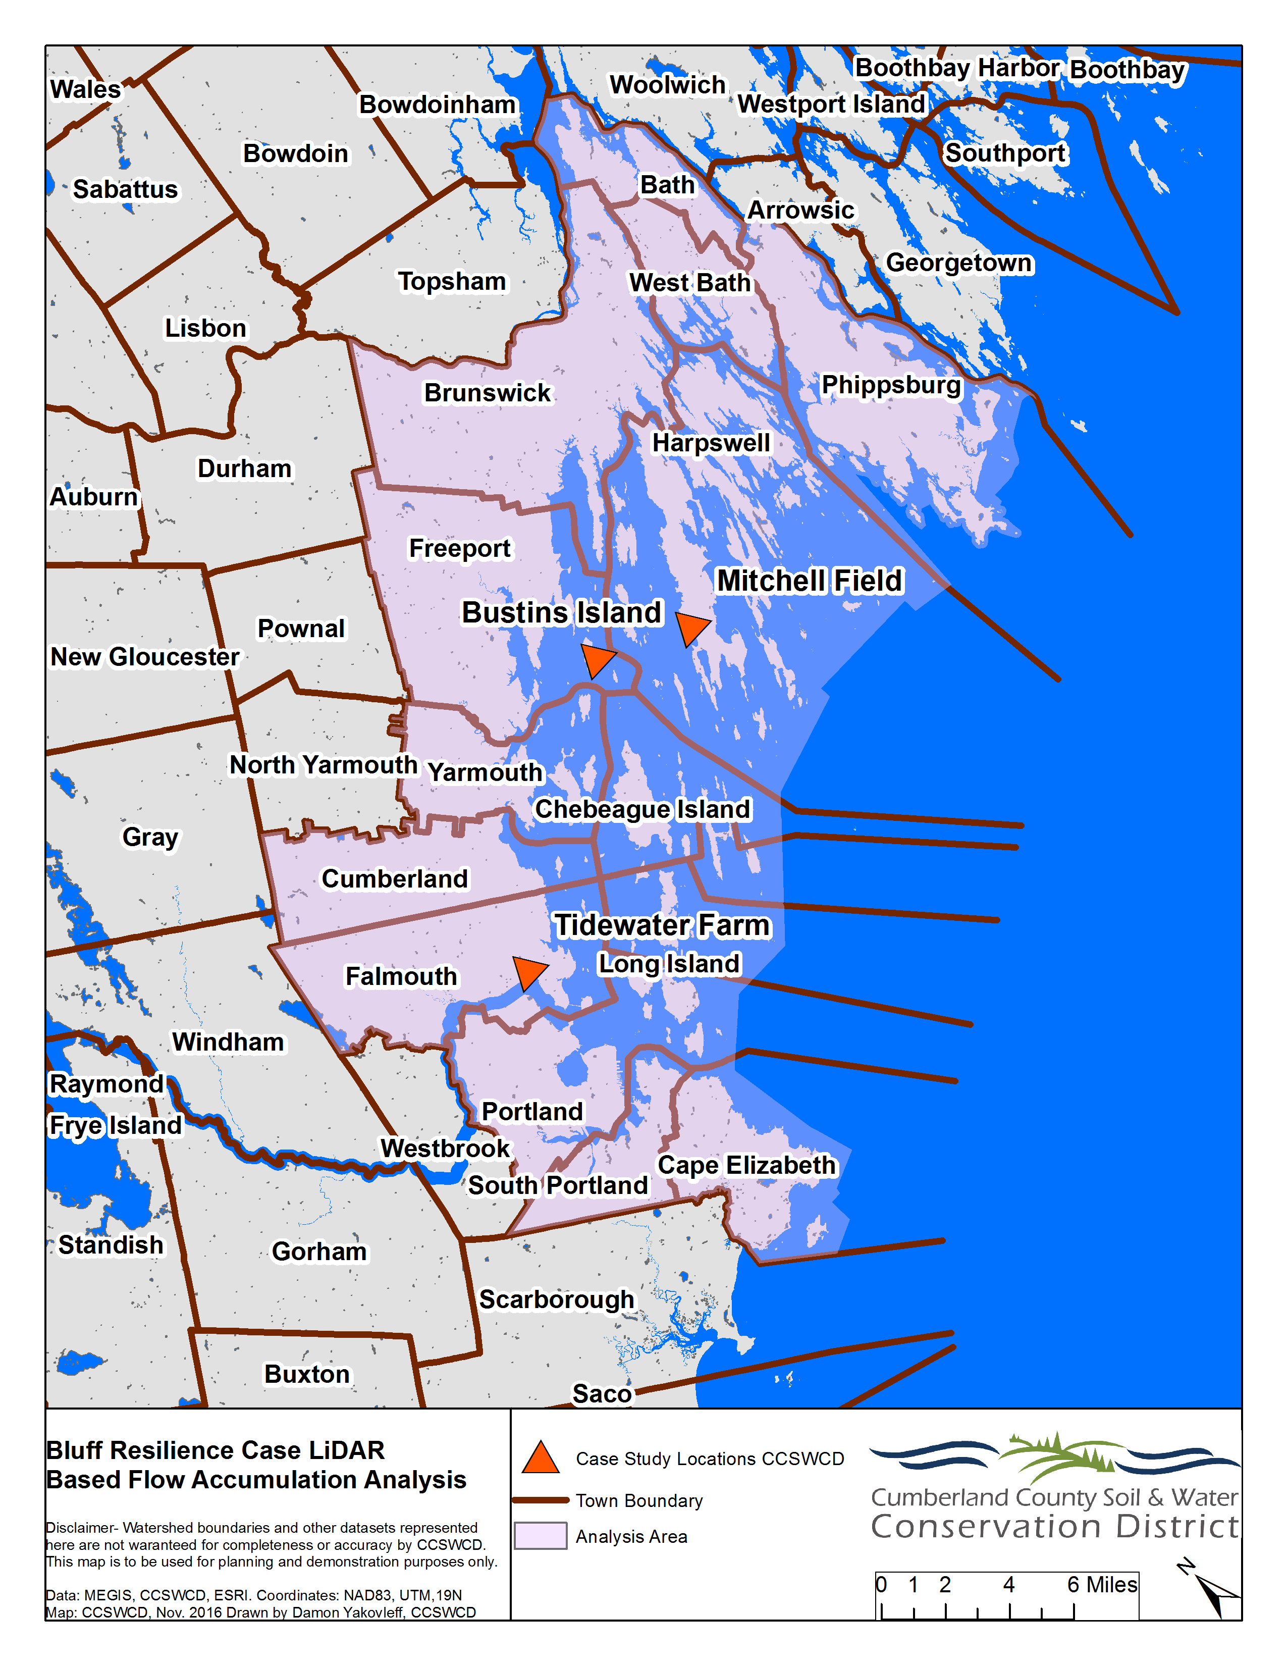
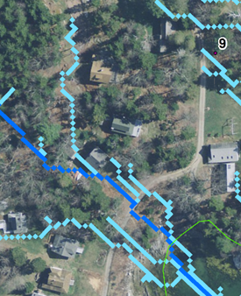
LiDAR Drainage Analysis

Slide 19
Site Overview
9 Bluff and 2 upland sites selected for analysis
Parameters analyzed
  Hydrology
  Stability (4-part assessment)

Slide 20
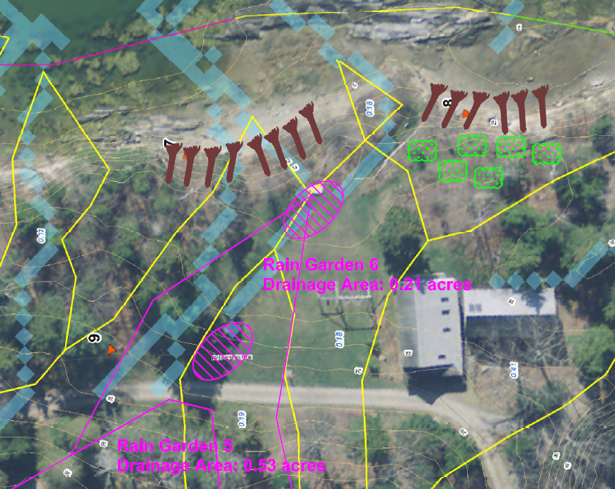
Prioritization
Study Sites 7, 8, 9: Address bluff erosion and upland discharge

Slide 21
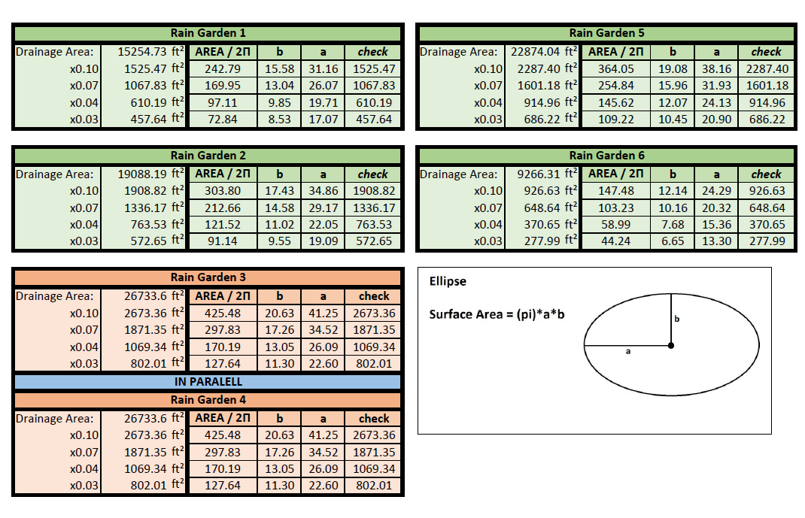

Slide 22
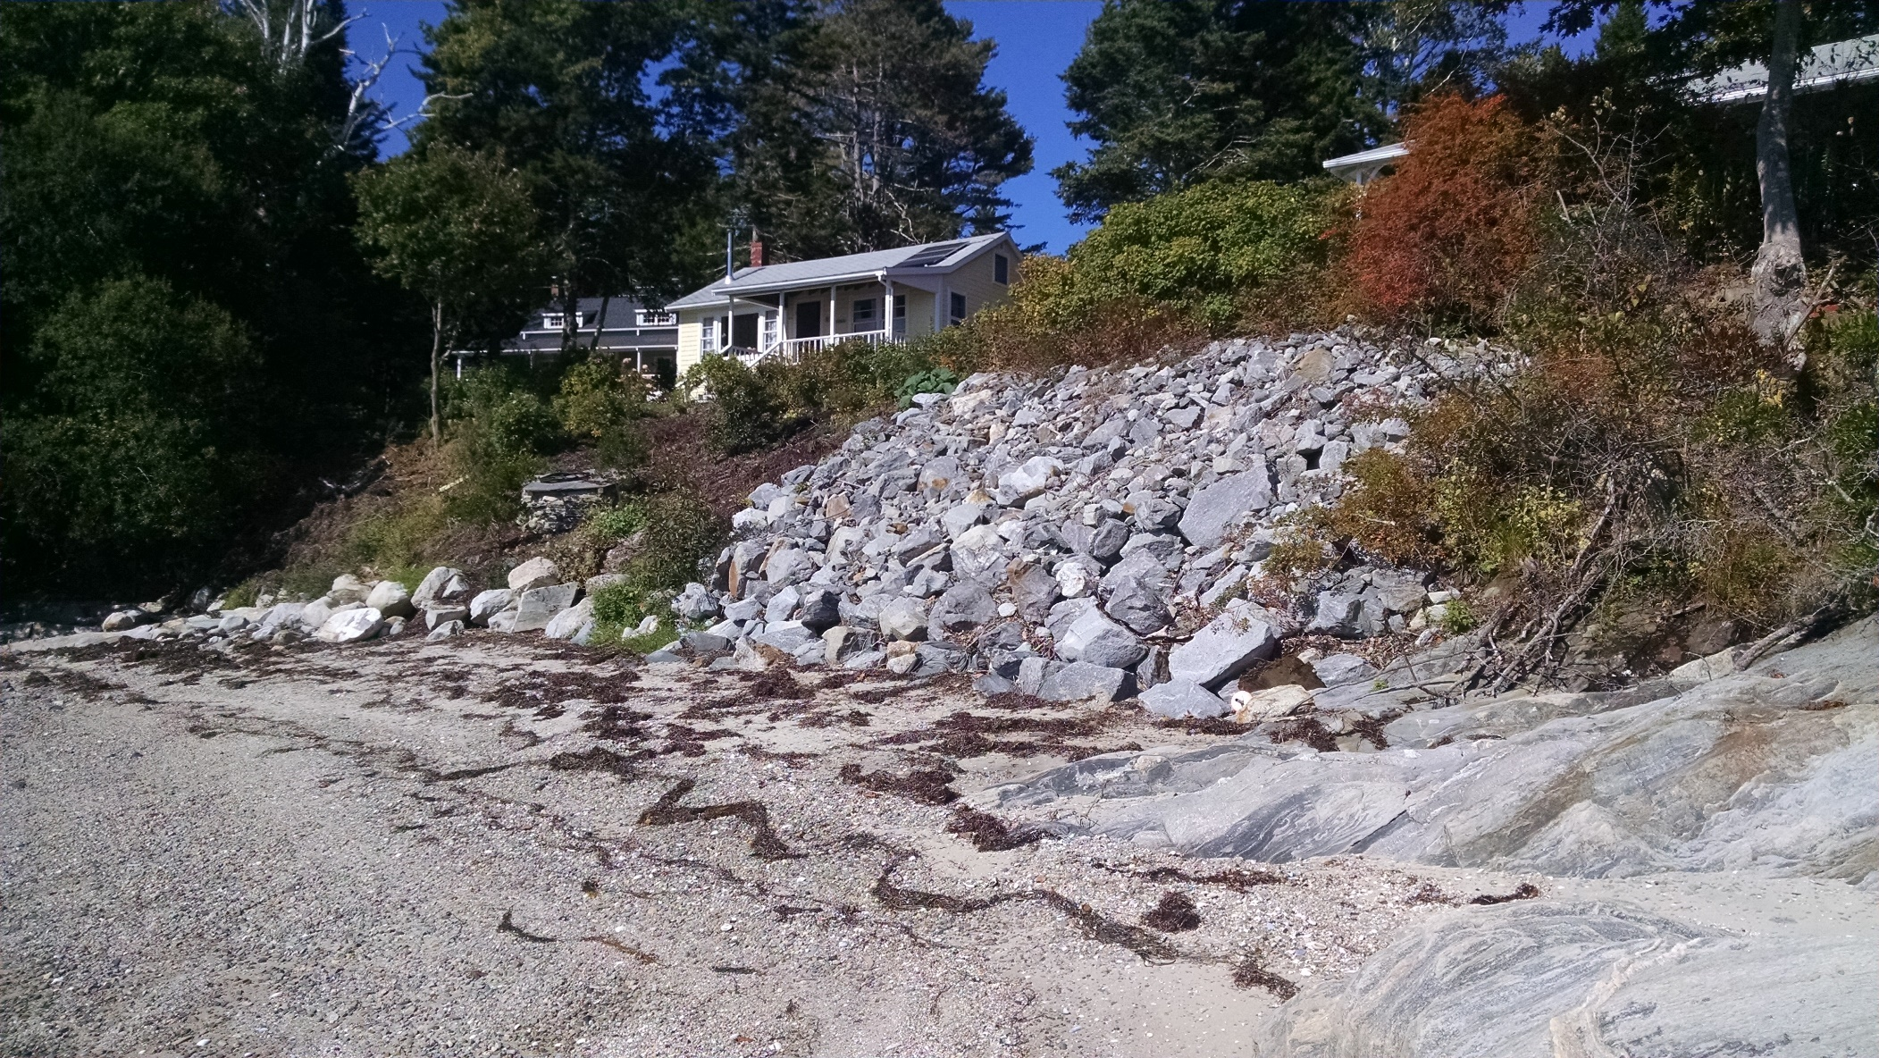
Vegetation vs Riprap
Living Shoreline
w/ Vegetation
Hardened Shoreline

Slide 23
Bustins Island Site Assessment Instability RLA (DRAFT 1 of 2)

Slide 24
Bustins Island Site Assessment Instability RLA (DRAFT 2 of 2)

Slide 25

Next Steps
Implementation options:
  NOAA Grant, administered by The Nature Conservancy
  Local actions

Slide 26
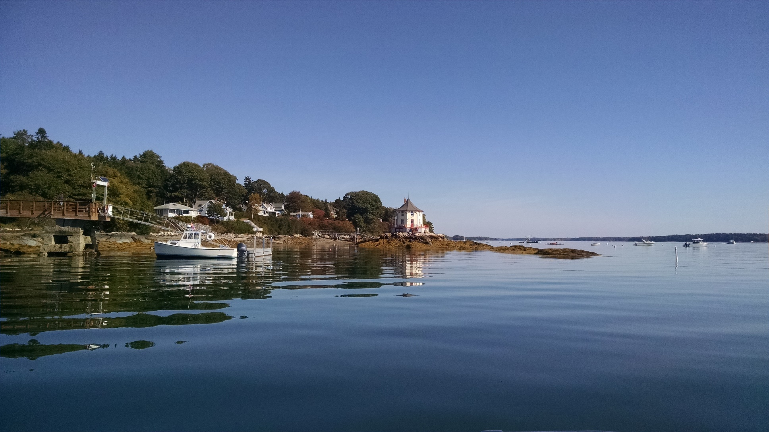
Discussion

Slide 27
Extended Theoretical Discussion

Slide 28
Fluvial Geomorphic Principles
Fluvial geomorphology - interactions between bluff form and fluvial processes
Upland – Riparian – Intertidal are complex interrelationships
Independent variables – upland discharge, geology, soils, landform, fetch, bathymetry and climate
Dependent variables – bluff slope stability, width, height, pattern change through complex feedback mechanisms
Changes in any independent variables or dependent variables initiate adjustment processes in one or more of the dependent variables

Slide 29
Instability Assessment Rating
(PLA)
12 Parameters
Good (1): 1-15
Fair (2): 16-27
Poor (3): 28-36

Slide 30
Shoreline Assessment Management (SMA)
DRAFT

Slide 31
SMA Decision Tree
DRAFT

Slide 32
Troy Barry, M.S. P.Eng
District Engineer – Fluvial Geomorphologist
Ph: (207) 892-4700
E-Mail: tbarry@cumberlandswcd.org
Developing a Decision Tree and Coastal Stabilization Alternatives
Along Maine’s Casco Bay
Introducing Green Infrastructure for Coastal Resilience May 17, 2017
Notes:
Note: The photos on the title slide are place holders. Replace them with photos relevant to your presentation.

